Slide 1


Introduction to Dynamo
powered by

Slide 2
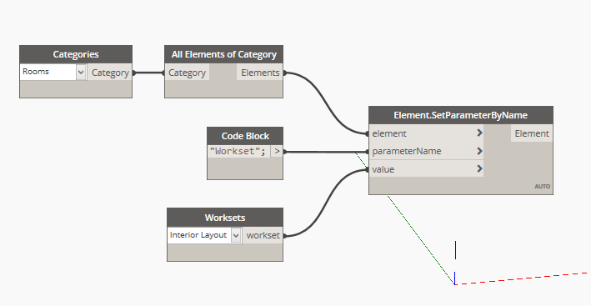
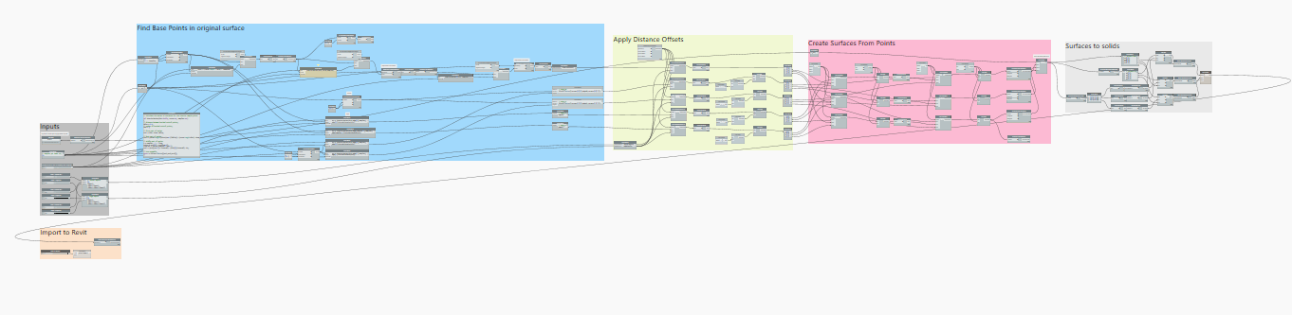
what is dynamo?
A visual programming tool that aims to be accessible to both non-programmers and programmers alike. It gives users the ability to visually script behavior, define custom pieces of logic, and script using various textual programming languages.

Slide 3
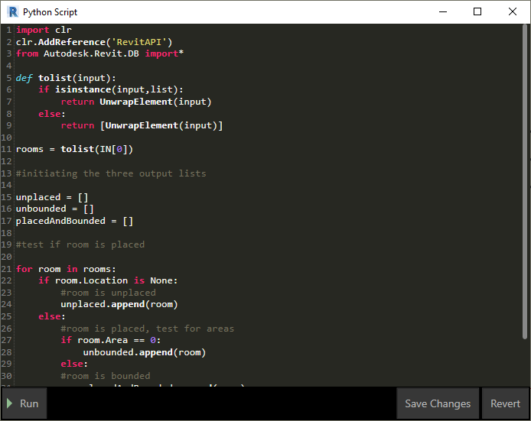
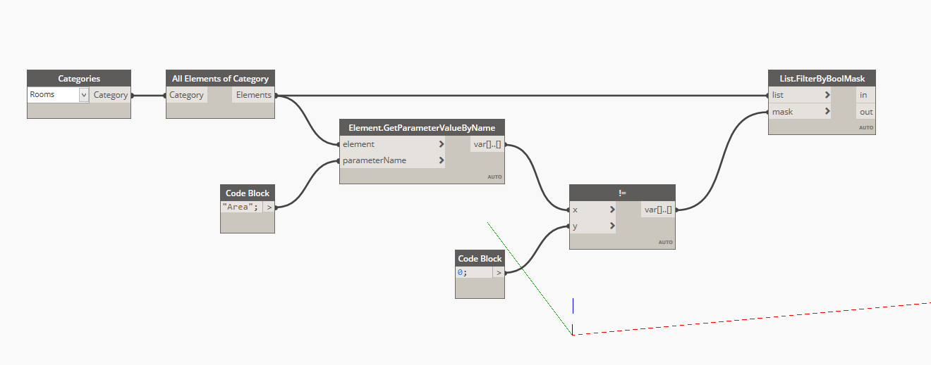
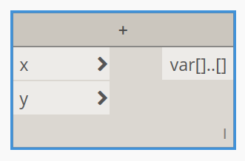
what is visual programming
Any programming language that lets users create programs by manipulating program elements graphically rather than by specifying them textually.
def calculation(x,y):
sum = x + y
return sum
python
dynamo

Slide 4





integration
revit
civil 3d
alias design
formit
advance steel

Slide 5
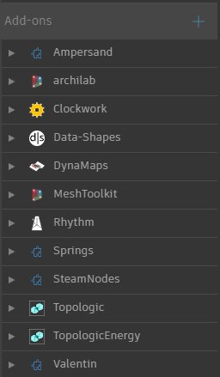
add-ons (aka packages)
my favorite
  Ampersand
  archilab
  Clockwork
  Data-Shapes
  Rhythm
  Springs

Slide 6



what are you getting out of it?
a basic understanding of Dynamo
a different mindset about logic
the ability to identify situations where Dynamo would be helpful

Slide 7
what can we do with dynamo
through a few real world examples

Slide 8

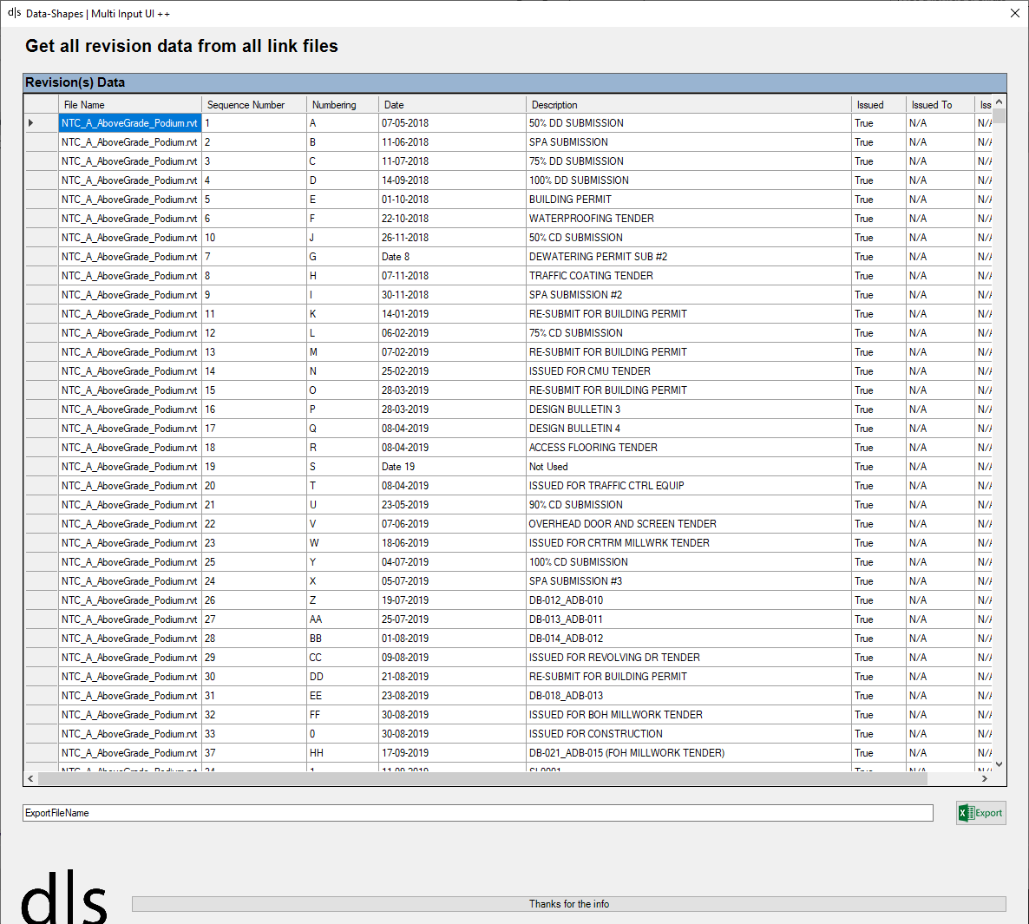
ntc - revision list

Slide 9
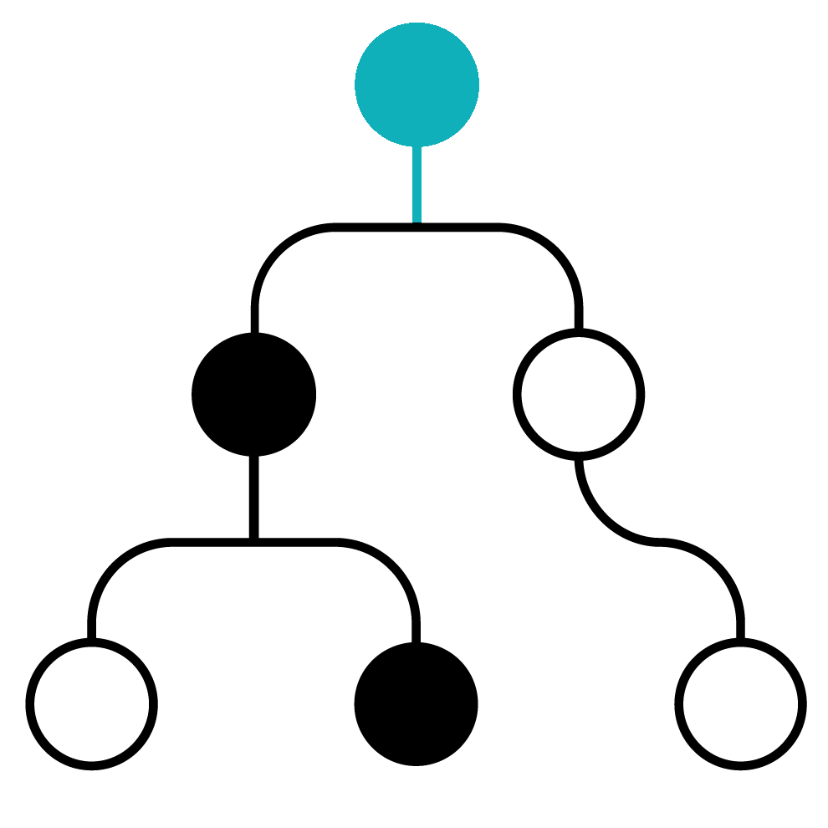
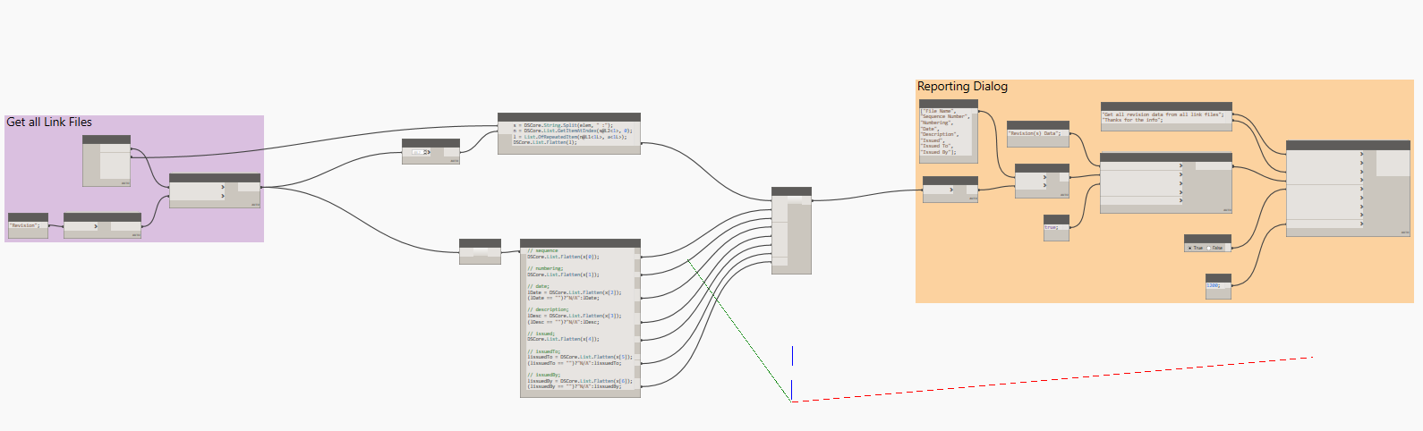
revision list
Get all the link files
Extract all the Revisions
Group & Sort them by Sheet
Display them in a Table

Slide 10

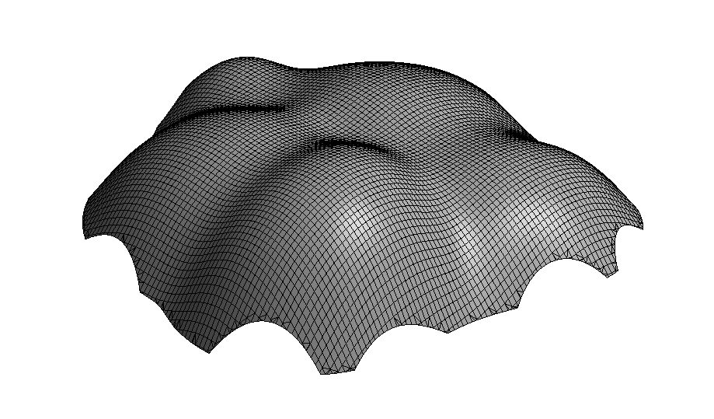
paneling

Slide 11
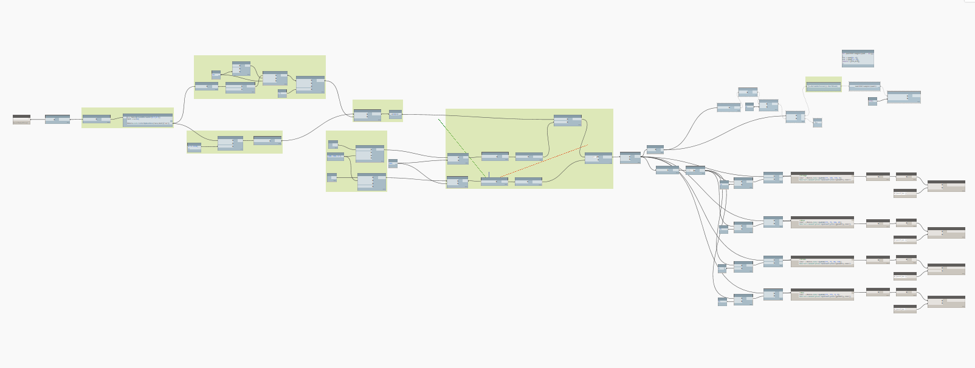
paneling
Import the .sat from Rhino
Recreate the outer shell in Dynamo
Divide the surface
Group all the points
Place the panels ~17 000

Slide 12
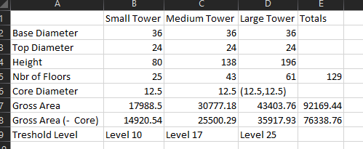
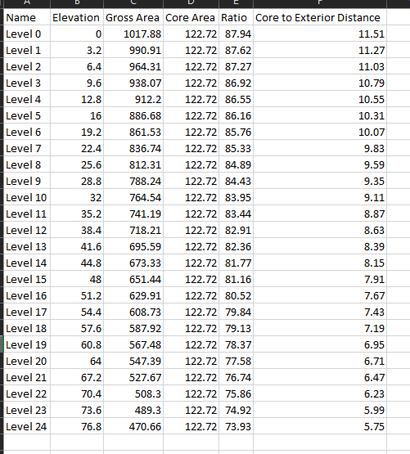
concept design

Slide 13
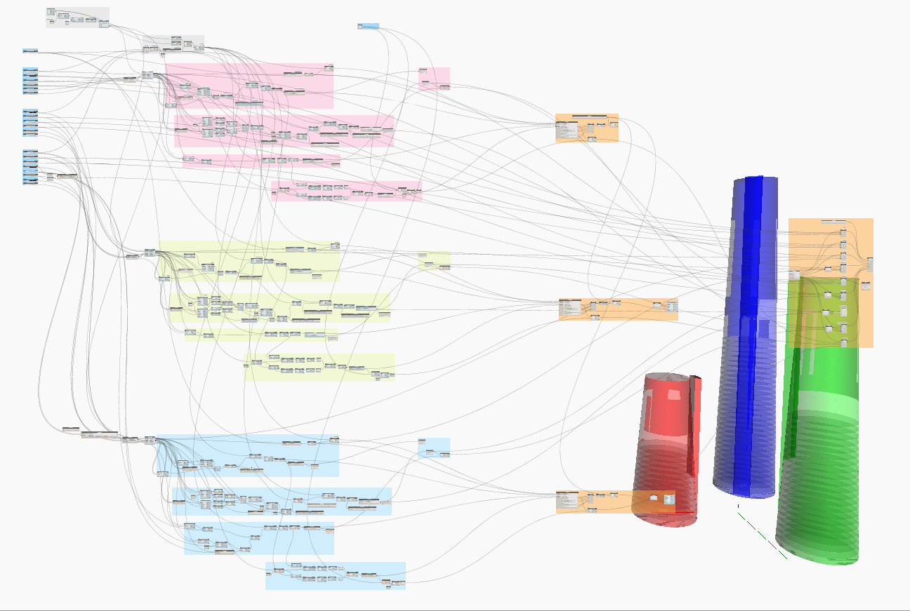
concept design
Create all 3 tower shape based on inputs
Create all 3 core based on input
Intersect them with the levels
Calculate area totals

Slide 14
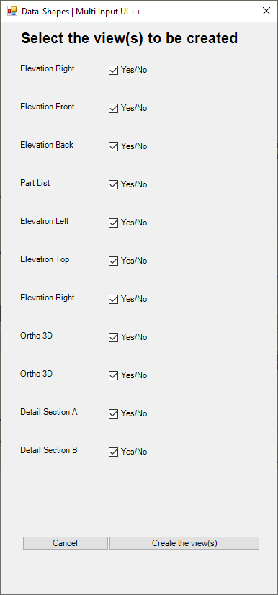
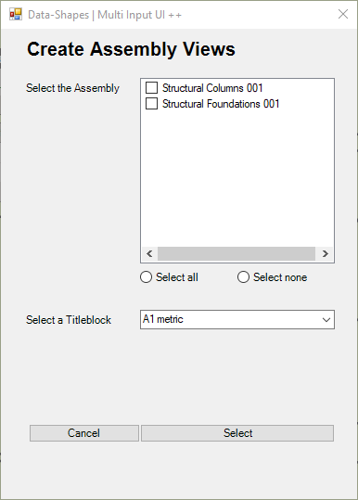
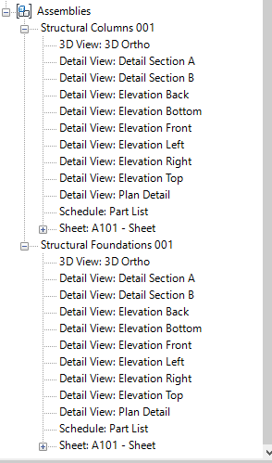
documentation

Slide 15
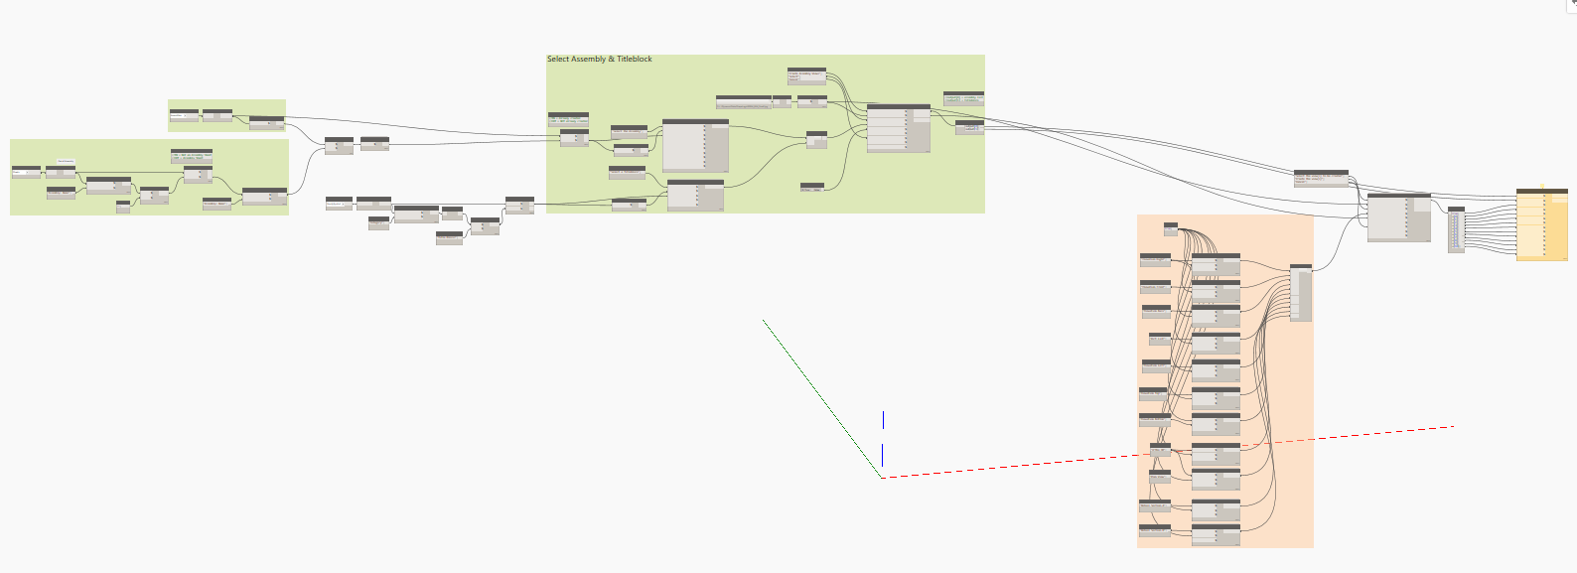
documentation
Get all the Assembly
Choose the required ones
Choose which Views to create
Place all views on sheets

Slide 16
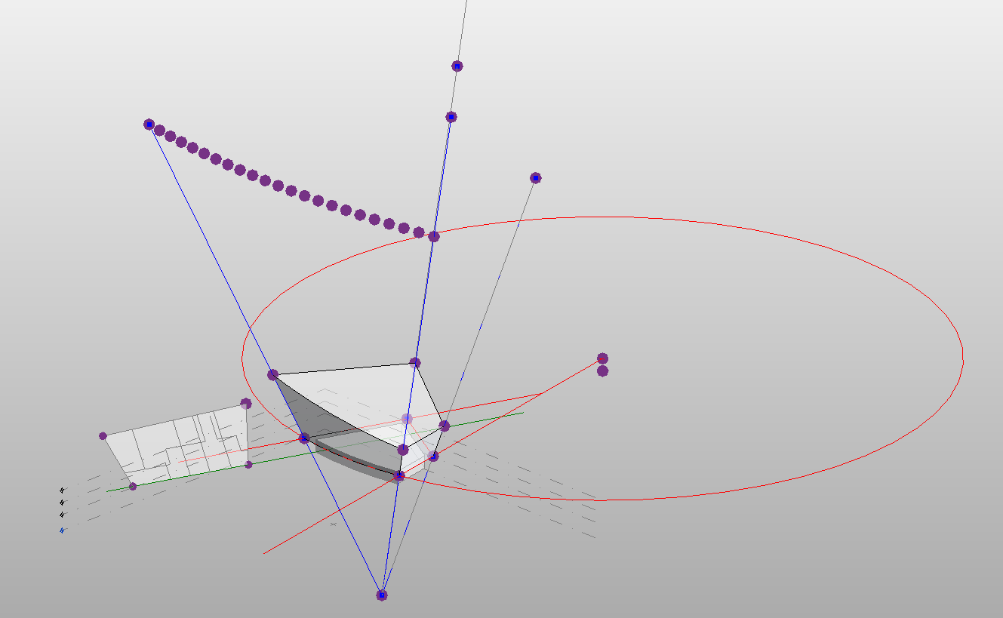
inital massing

Slide 17
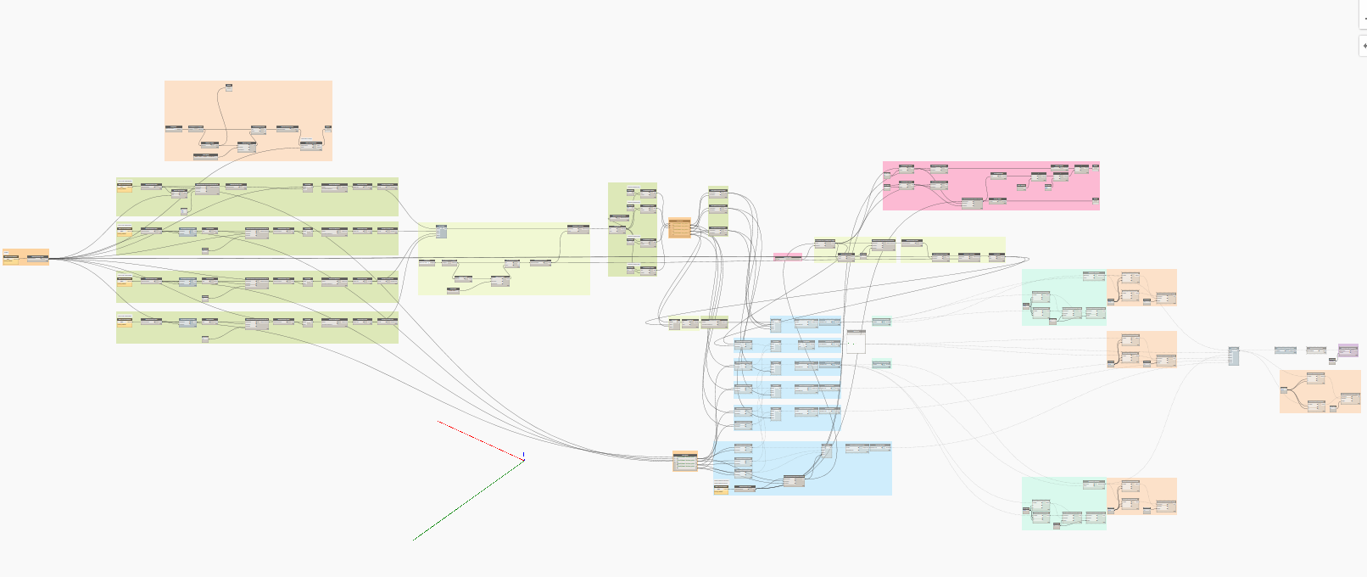
inital massing
Create the bottom surface of the mass
Connect the surface vertices with the origin point
Create the sloped surfaces based on the origin point "gravity lines"
Close the faces
Create the mass

Slide 18
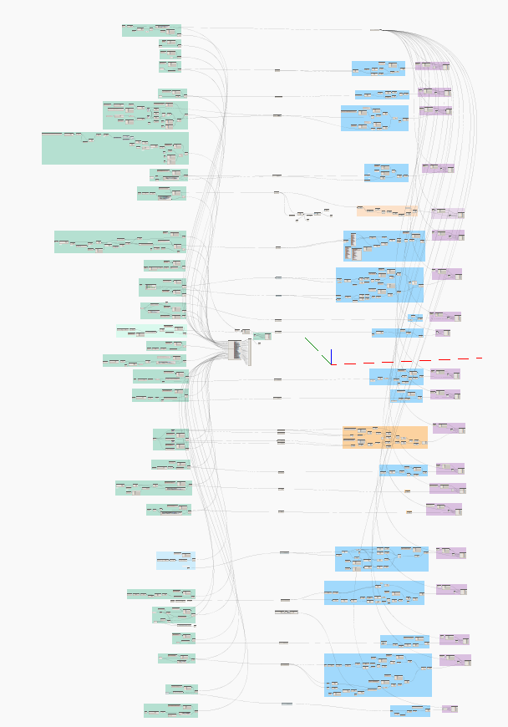
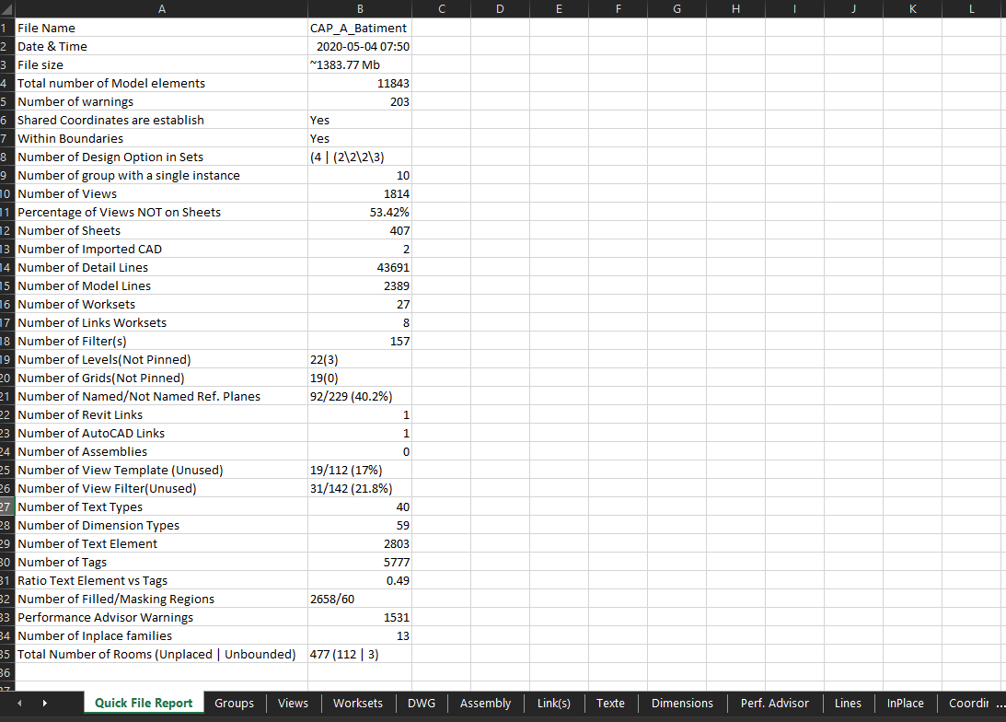
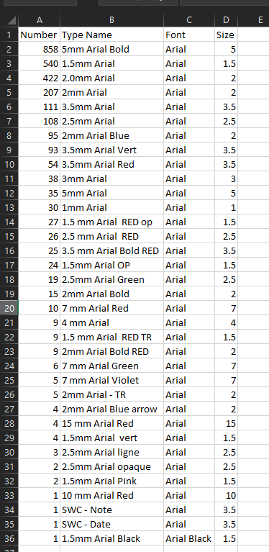
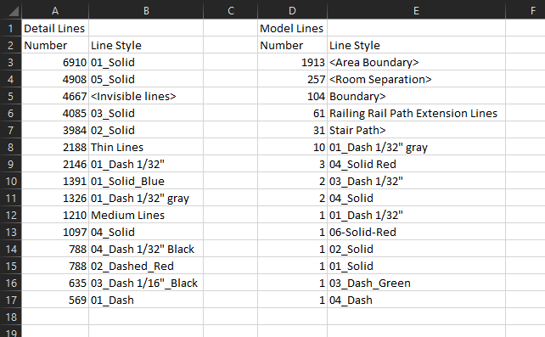
model auditing

Slide 19

let’s get started… with the basics
then a few simple exercises

Slide 20
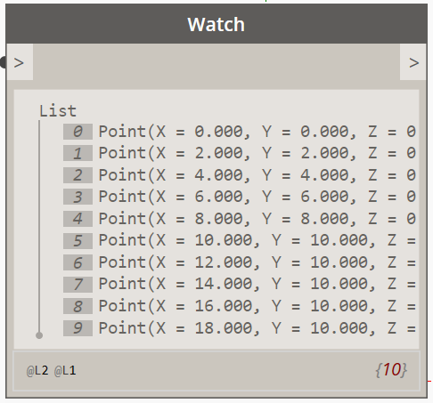
what is a List?
A collection of elements
  Every element in a list have an [index]
  List are zero-based, meaning that the first element [index] is 0
  List have Levels
Index [0]
List of Points
Levels

Slide 21
list lacing (short)
List 1
List 2
A
0
A0
B
1
B1
2
3
4
5
6
7

Slide 22
list lacing (long)
List 1
List 2
A
0
A0
B
1
B1
2
B2
3
B3
4
B4
B5
5
B6
6
B7
7

Slide 23
list lacing (cross product)
List 1
List 2
A
0
A0
B0
B
1
A1
B1
2
A2
B2
3
A3
B3
4
A4
B4
5
A5
B5
6
A6
B6
7
A7
B7

Slide 24
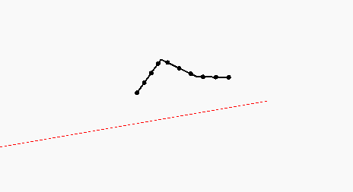
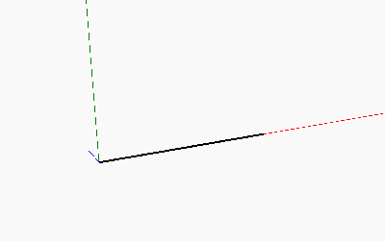
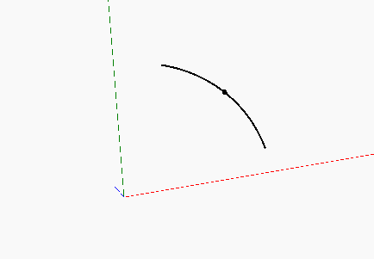
basic curves (and their concept)
Polycurve
Line
Arc

Slide 25

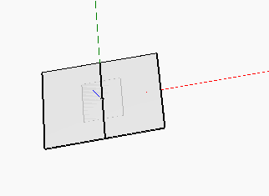
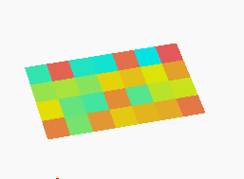
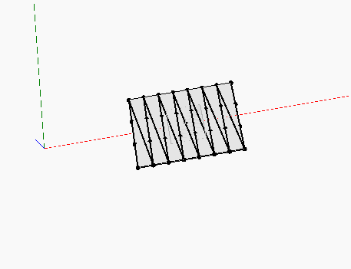
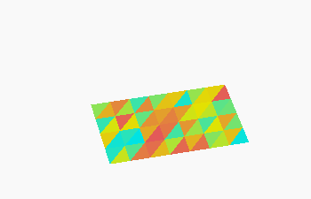
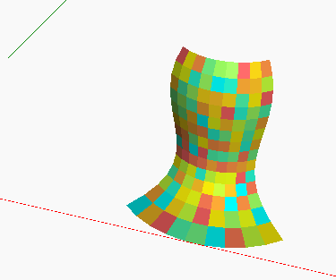
basic surfaces (and their concept)

